Slide 1
Zuckflix Content Recommendations
2022 Meta Data Challenge
Enock Niyonkuru
Trinity College

Slide 2

TL;DR, Data Insight
Part1: Content Recommendation
Focus on Movies more at the beginning instead of TV Shows
Adding movies in the same year as they are released
Movies for adults are a priority, and then teens
The top 10% of Genre has 45% of all the content, primarily International Movies, Dramas, and Comedies
It is not significant to focus on a single cast,
44% of the cast appeared in one movie or TV show
Top 10% cast has only 27% of all the movies &TV Show
Top 20 directors have 4% of all the directors, most directors are Americans
Most of the movies were produced in the US (32%), and India (10%)
Part 2: Country Recommendation
The United States

Slide 3
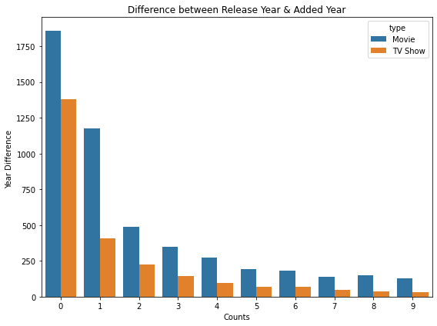
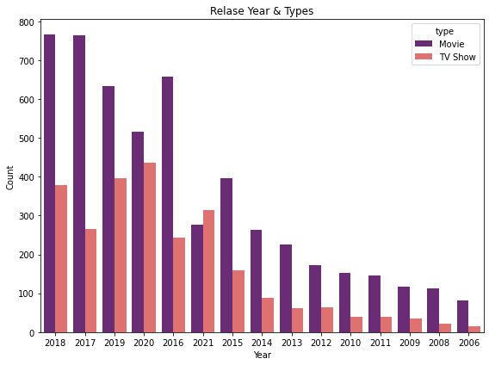
The Trend in Type and Release Year
Most of movies & TV Shows are added less than 1 year after being released
Movies content is larger than TV Shows as time increases

Slide 4
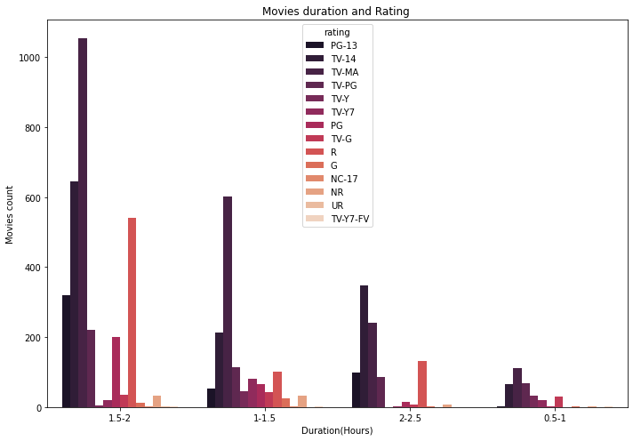
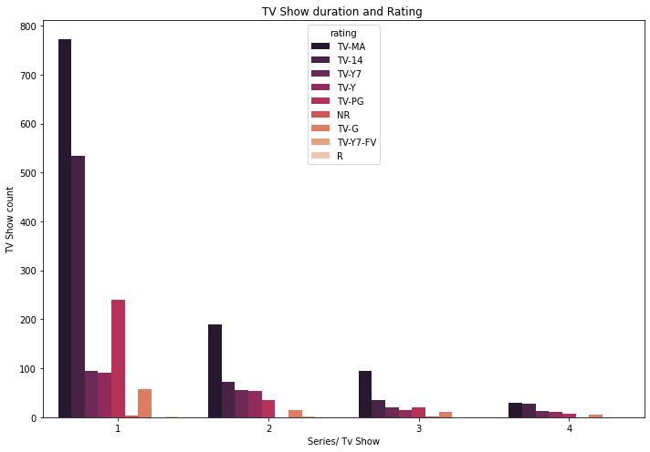
Movies / TV Show Duration and Rating
Common movies
Durations: between 1 -2 hours
Rating: Mostly Adults (TV-MA & TV-14)
Common TV Shows
Durations: 1 series
Rating: Mostly Adults (TV-MA & TV-14)

Slide 5
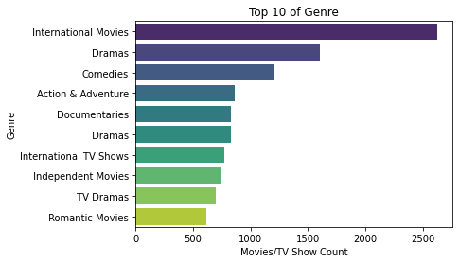
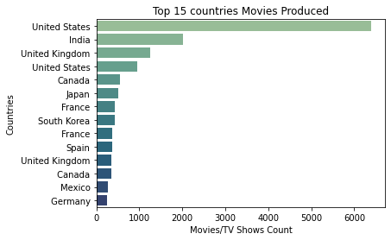
Genre & Country Production
Top 10% of Genre has 45% of all the TV shows & Content
Most movies were produced in the US (32%) and India (10%)

Slide 6
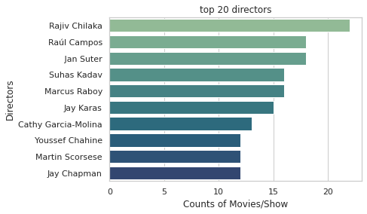
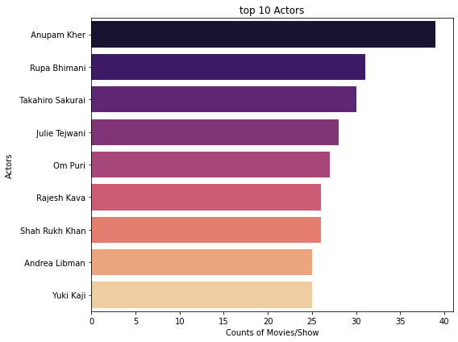
Directors & Cast Insight
DIRECTORS:
The top 20 Directors have 4% of all the directors
Most directors are Americans & Indians
CAST:
44% of the cast appeared in one movie or TV show
TV show actors are mostly common to occur in multiple shows than movie actors

Slide 7
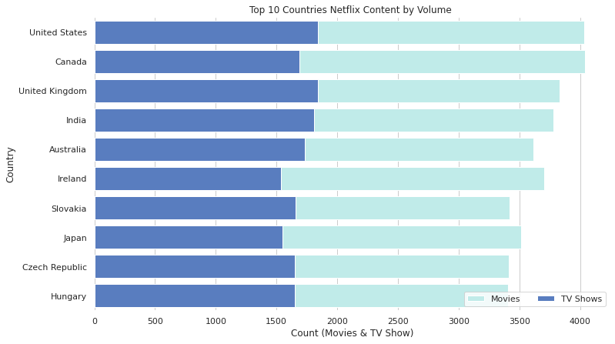
Country Recommendation:
Country: The United States
Ranked 1st in Netflix content by volume (FlixWatch, the largest Netflix database)
The second-largest market of Facebook with 240.0 Million users (2020-2021) (world population review)
Content:
Comedy, Animation & Drama Genre

Slide 8
Conclusion
Content Recommendation of Zuckflix:
Movies approximately one to two hours long, geared toward adults (at least 17 years old), movies in the international, drama, and comedy genres that are produced in the US, and are directed by an American director should be the starting point.
Begin with the US as the first country, start with Drama & Comedy genre in addition to the above recommendation

Slide 9
Any Questions?
Thank You!

